Slide 1
Café POS System
Ashika Balami
BIM2021
TU roll No. 13371/21

Slide 2
Problem Statement
Inefficient manual transaction and inventory management leading to errors and delays.
Lack of a centralized system for tracking sales, customer orders, and stock updates.
Difficulty in analyzing sales trends and making data-driven business decisions.

Slide 3
Objectives
To develop a user-friendly, scalable, and efficient POS system for café operations using the MERN stack.
To integrate essential features such as order management, real-time billing, sales analytics, and customer data management.

Slide 4
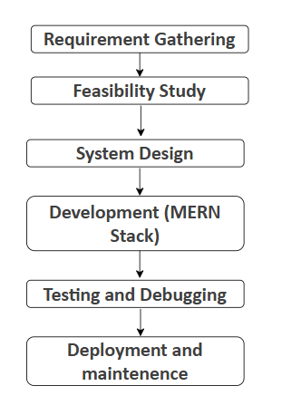
Research Methodology

Slide 5




Proposed Tools

Slide 6
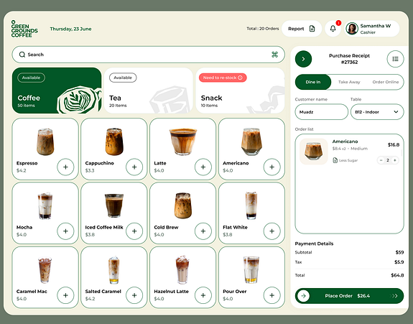
Deliverables

Slide 7
Conclusion
The proposed Café POS System will automate sales processing, reduce human error, and enhance operational efficiency.
Real-time data synchronization and analytics will enable café owners to make informed business decisions.

